Slide 1

MediTranscribe: Medical Transcription Portal
By Ramjee Mishra / 150096725007
Case Study Number: 52

Slide 2
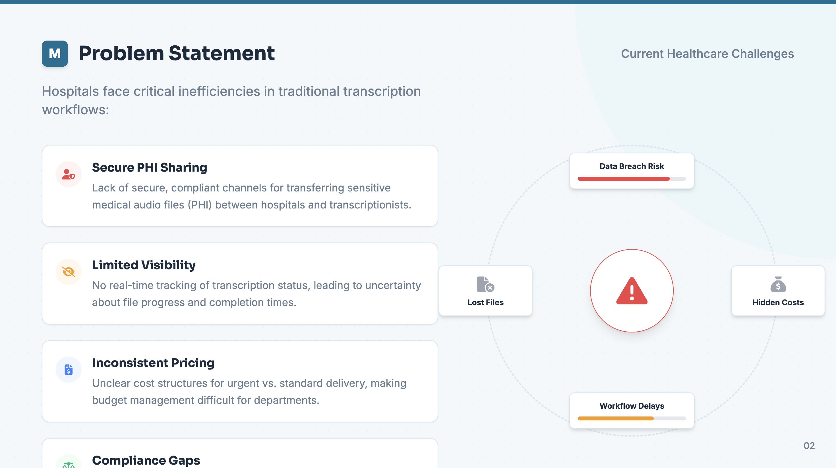

Slide 3
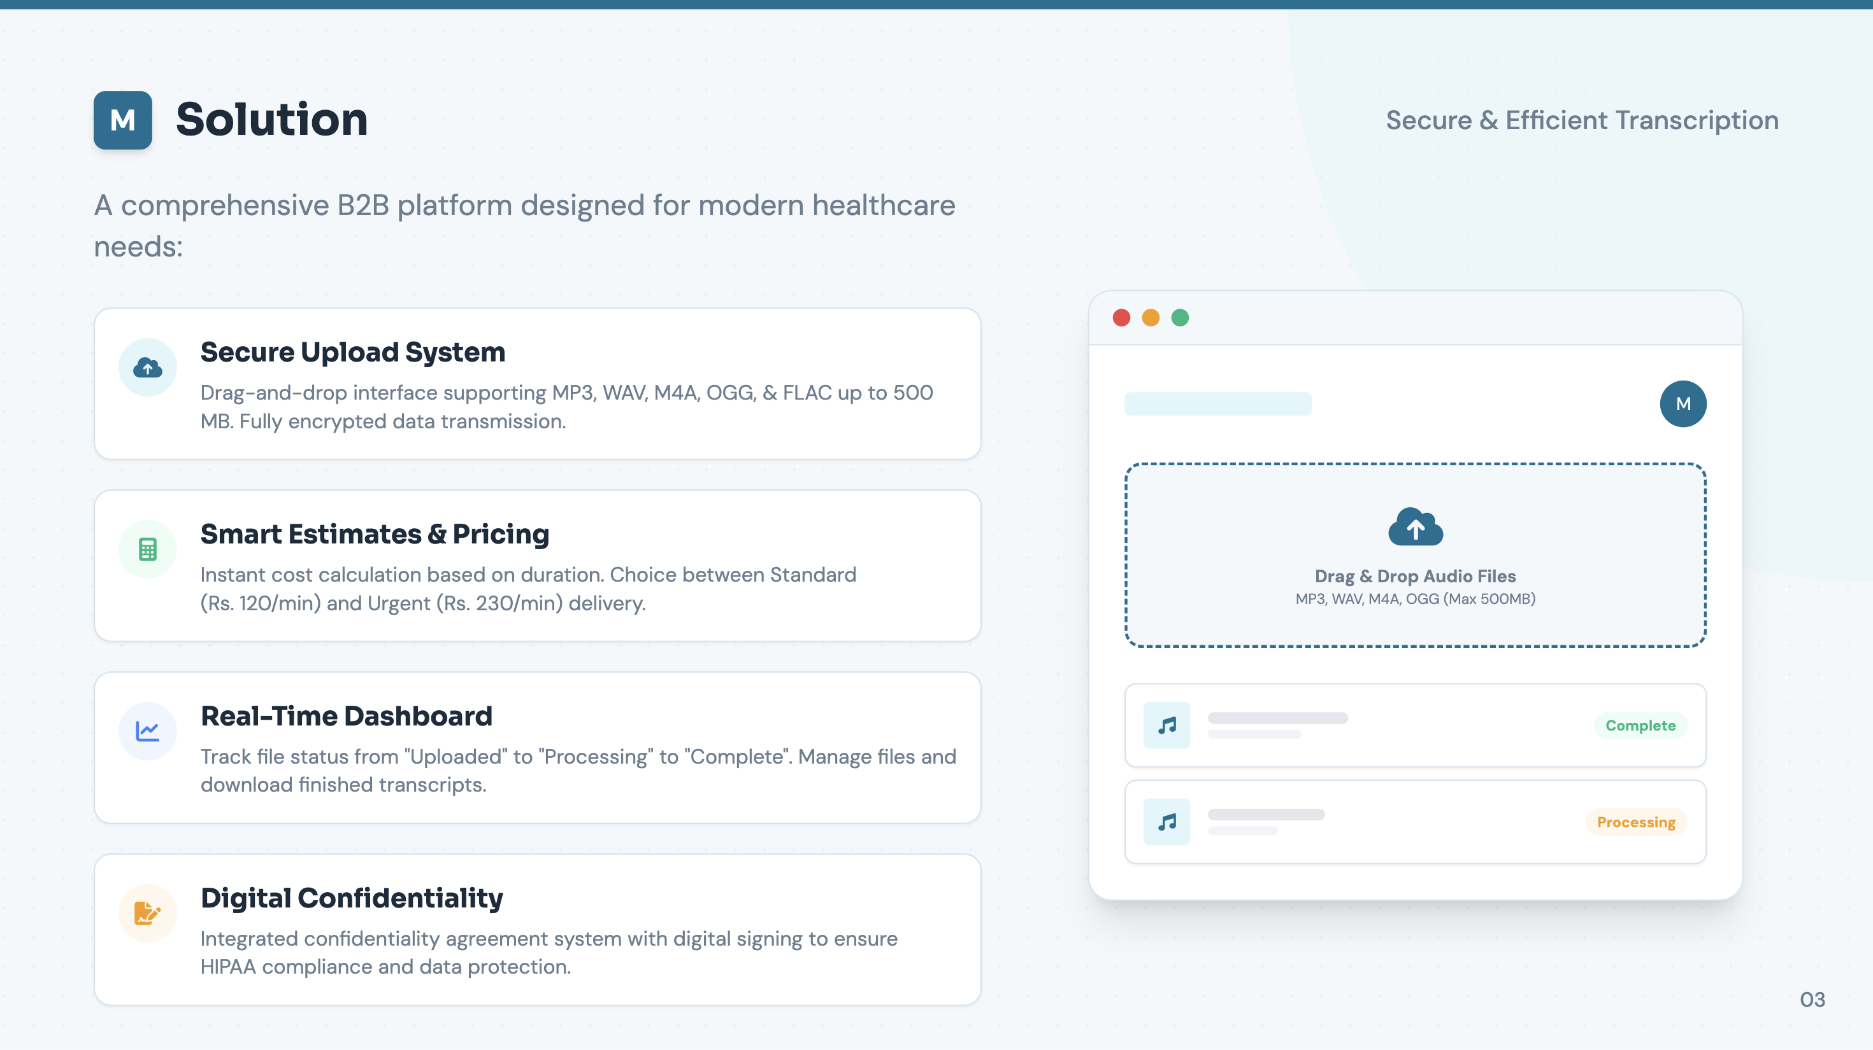

Slide 4
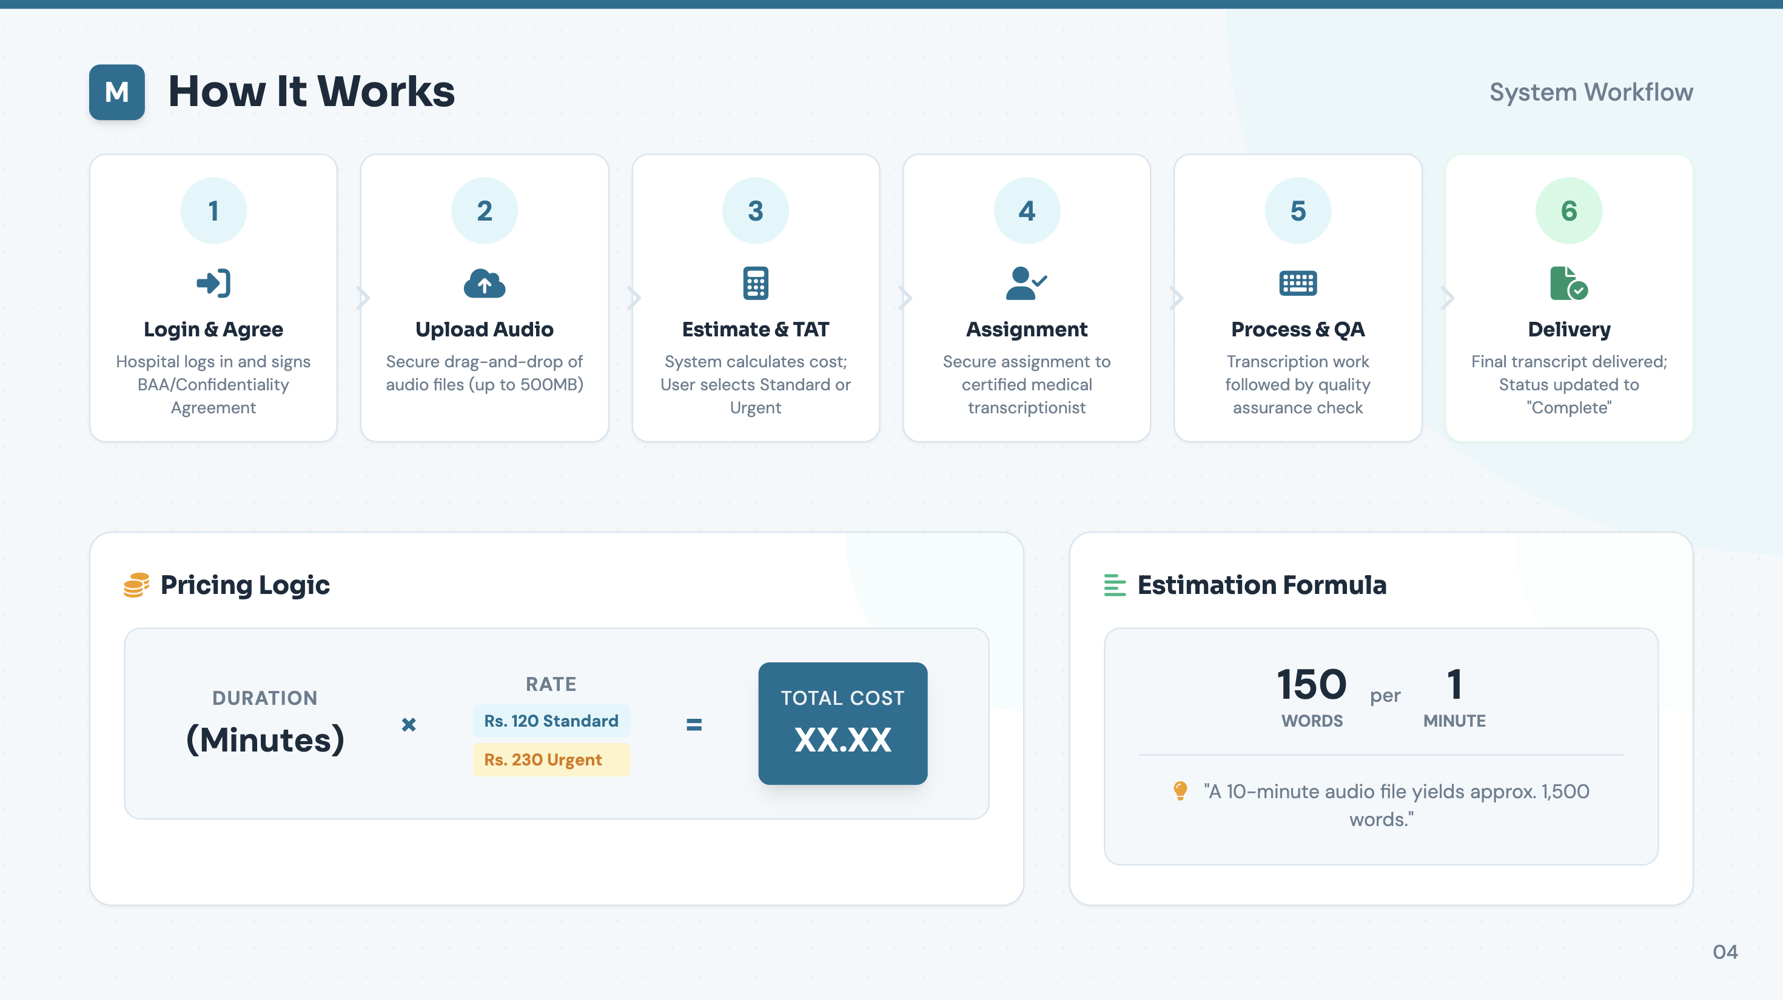

Slide 5
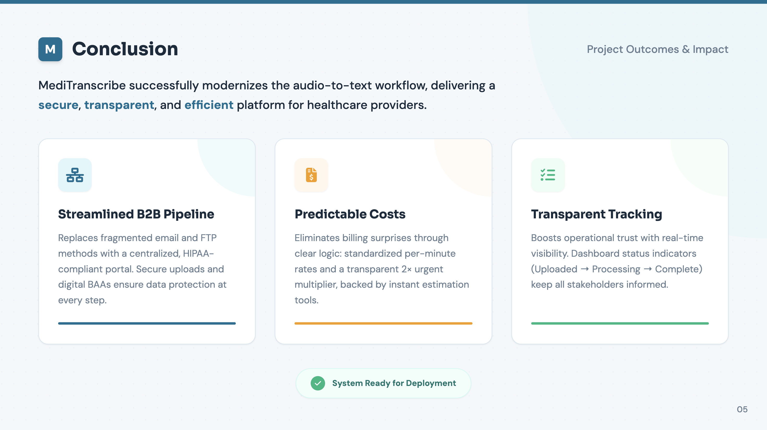

Slide 6
Thank You

